Slide 1
SINGLE-SOURCE SHORTEST PATHS
Graph Algorithms-IV

Slide 2
Introduction
Generalization of BFS to handle weighted graphs
Direct Graph G = ( V, E ), edge weight fn ; w : E → R
In BFS w(e)=1 for all e Î E
Weight of path p = v₁ → v₂ → … → v_{k} is

Slide 3
Shortest Path
Shortest Path = Path of minimum weight
δ(u,v)=
p
min{ω(p) : u v}; if there is a path from u to v,
∞ otherwise.

Slide 4
Shortest-Path Variants
Shortest-Path problems
Single-source shortest-paths problem: Find the shortest path from s to each vertex v. (e.g. BFS)
Single-destination shortest-paths problem: Find a shortest path to a given destination vertex t from each vertex v.
Single-pair shortest-path problem: Find a shortest path from u to v for given vertices u and v.
All-pairs shortest-paths problem: Find a shortest path from u to v for every pair of vertices u and v.

Slide 5
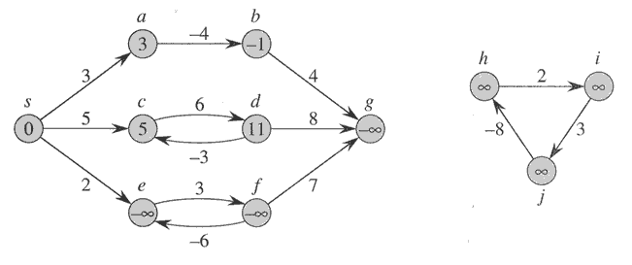
Negative-weight edges
No problem, as long as no negative-weight cycles are reachable from the source
Otherwise, we can just keep going around it, and
get w(s, v) = −∞ for all v on the cycle.

Slide 6
Relaxation
Maintain d[v] for each v Î V
d[v] is called shortest-path weight estimate
INIT(G, s)
for each v ∈ V do
d[v] ← ∞
π[v] ← NIL
d[s] ← 0

Slide 7
Relaxation
RELAX(u, v)
if d[v] > d[u]+w(u,v) then
d[v] ← d[u]+w(u,v)
π[v] ← u
The process of relaxing an edge(u,v) consists of testing whether we can improve the shortest path to v found so far by going through u,If so, update v.d and v. π
u
v
u
v
2
2
5
9
5
6
Relax(u,v)
5
7
5
6
2
2
u
v
u
v

Slide 8
Dijkstra’s Algorithm For Shortest Paths
Non-negative edge weight
Like BFS: If all edge weights are equal, then use BFS, otherwise use this algorithm
Use Q = priority queue keyed on d[v] values
(note: BFS uses FIFO)

Slide 9
Dijkstra’s Algorithm For Shortest Paths
Total time: O(V+VlgV + ElgV) = O(ElgV)
DIJKSTRA(G, s)
INIT(G, s)
S←Ø
Q←V[G]
while Q ≠Ø do
u←EXTRACT-MIN(Q)
S←S U {u}
for each v Î Adj[u] do
RELAX(u, v,w)
O(V)
O(V) if Q is implemented as a min-heap
Min-heap operations:
O(VlgV)
Takes O(lgV)
Executed O(E) times
O(ElgV)
Takes O(lgV)

Slide 10
Example
u
v
∞
1
∞
10
0
2
3
9
s
4
6
7
5
∞
∞
2
x
y

Slide 11
Example
u
v
10
1
∞
10
9
0
2
3
s
4
6
7
5
5
∞
2
x
y

Slide 12
Example
u
v
8
1
14
10
0
2
3
9
s
4
6
7
5
5
7
2
x
y

Slide 13
Example
u
v
8
1
13
10
2
3
9
s
0
4
6
7
5
5
7
2
x
y

Slide 14
Example
u
v
8
1
9
10
0
2
3
9
s
4
6
7
5
5
7
2
x
y

Slide 15
Example
u
v
8
1
9
10
2
3
9
0
4
6
s
7
5
5
7
2
x
y

Slide 16
Dijkstra’s Algorithm For Shortest Paths
Observe :
Each vertex is extracted from Q and inserted into S
exactly once
Each edge is relaxed exactly once
S = set of vertices whose final shortest paths have already been determined
i.e. , S = {v Î V: d[v] = δ(s, v) ≠ ∞ }

Slide 17
Dijkstra’s Algorithm For Shortest Paths
Similar to BFS algorithm: S corresponds to the set of black vertices in BFS which have their correct breadth-first distances already computed
Greedy strategy: Always chooses the closest(lightest) vertex in Q = V-S to insert into S
Relaxation may reset d[v] values

Slide 18
Dijkstra’s Algorithm For Shortest Paths
Similar to Prim’s MST algorithm: Both algorithms
use a priority queue to find the lightest vertex outside a
given set S
Insert this vertex into the set
Adjust weights of remaining adjacent vertices outside the set accordingly

Slide 19
Dijkstra’s Algorithm-Disadvantages
3
s
t
5
-10
v
u
2

Slide 20



Dijkstra’s Algorithm-Disadvantages
/-3
0
$$∞/3$$
3
s
t
5
-10
v
u
2
$∞$/5
$∞$/7

Slide 21
Dijkstra’s Algorithm For Shortest Paths
Example: Run algorithm on a sample graph
10
2
0
s
3
4
5
1

Slide 22
Dijkstra’s Algorithm For Shortest Paths
Example: Run algorithm on a sample graph
∞ 10 9 8
10
2
0
s
∞ 6
3
4
5
1
∞ 5

Slide 23
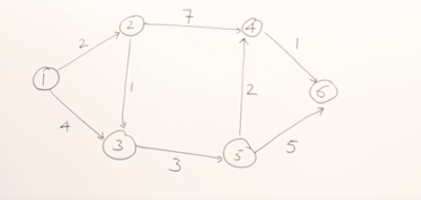
Problem

Slide 24
All-Pair Shortest Path
The Floyd-Warshall Algorithm

Slide 25
A recursive solution to the all-pairs shortest paths problem:
Let d_{ij}^{(k)} be the weight of a shortest path from vertex i to vertex j with all intermediate vertices in the set {1,2,…,k}. A recursive definition is given by
d_{ij}^{(k)}= w_{ij} if k=0,
min(d_{ij}^{(k-1)},d_{ik}^{(k-1)}+d_{kj}^{(k-1)}) if k 1.
The matrix D^{(n)}=(d_{ij}^{(n)}) gives the final answer-d_{ij}^{(n)}= for all i,j V-because all intermediate vertices are in the set {1,2,…,n}.

Slide 26
Computing the shortest-path weights bottom up:
FLOYD-WARSHALL(W)
n rows[W]
D⁽⁰⁾ W
for k 1 to n
do
for i 1 to n
do for j 1 to n
d_{ij}^{(k)} min(d_{ij}^{(k-1)},d_{ik}^{(k-1)}+d_{kj}^{(k-1)})
return D^{(n)}

Slide 27
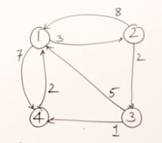
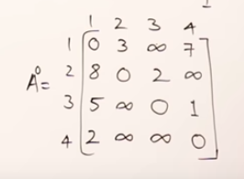
Example:

Slide 28
